Slide 1
Opportunities for Professional Development: National Council for Undergraduate Research (NCUR) 2019
Location: Kennesaw State University
Kennesaw, Georgia

Slide 2
National Conference on Undergraduate Research
NCUR began in 1987
(Lafayette sent four students that year)
In 2019, the conference is at Kennesaw State University, Kennesaw, GA
April 11-13 (Thursday-Saturday)
There will be 3,500+ attending

Slide 3
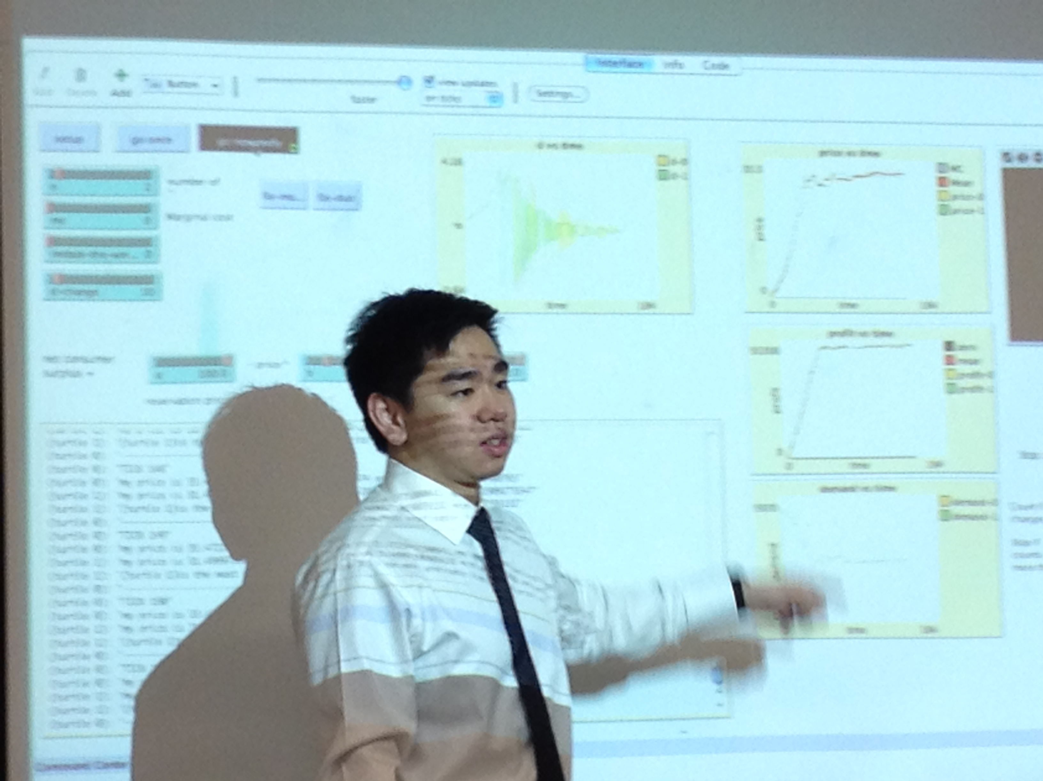
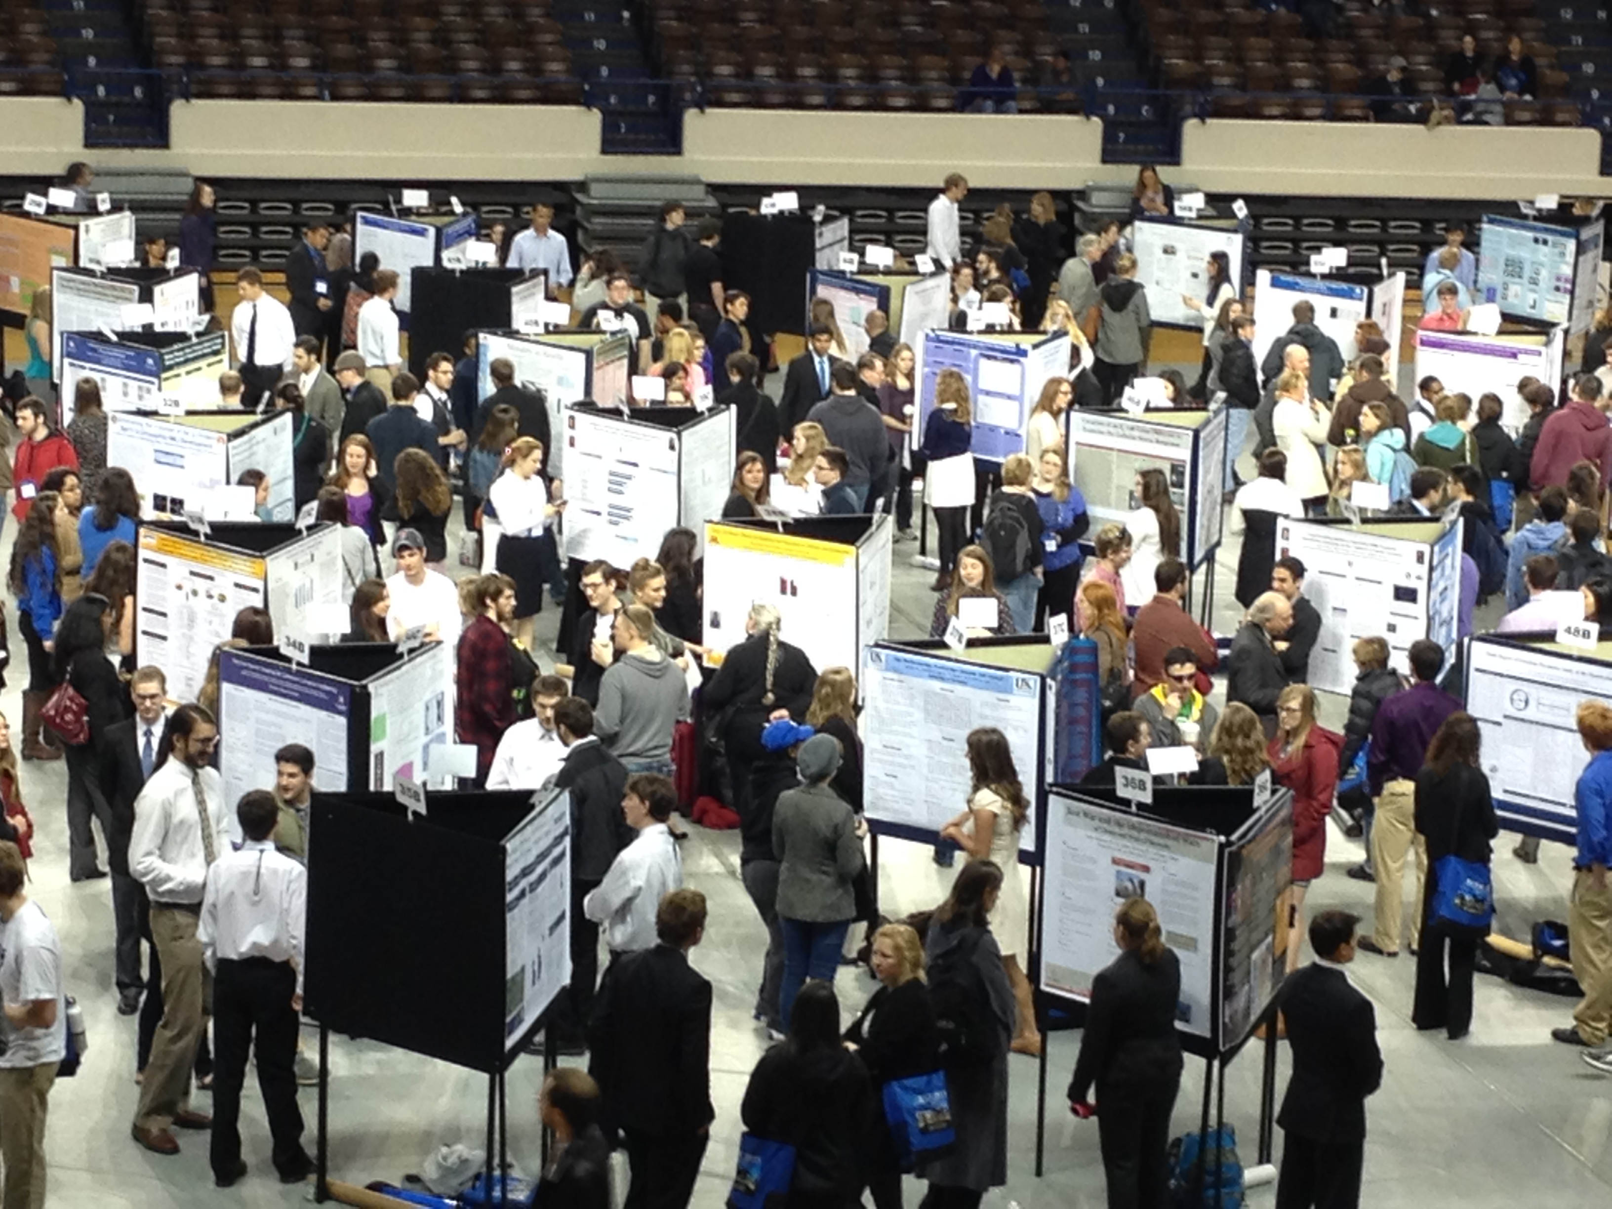
Types of Presentations
NCUR welcomes presentations from Humanities, Social Science, Natural Science, and Engineering, as well as interdisciplinary programs
The formats for presentations range from posters, talks, performances, and visual media.

Slide 4
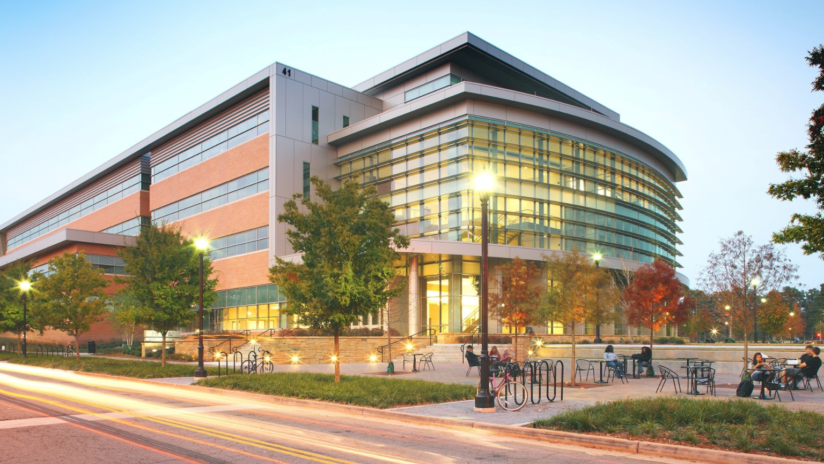
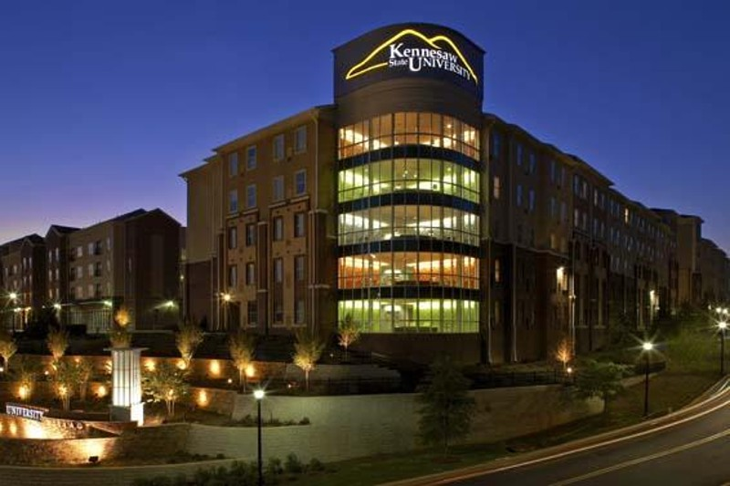
Conference Program
Plenary speakers (writers and poets, scientists) and exhibitions.
Swag, t-shirts,
And thousands of student talks …

Slide 5
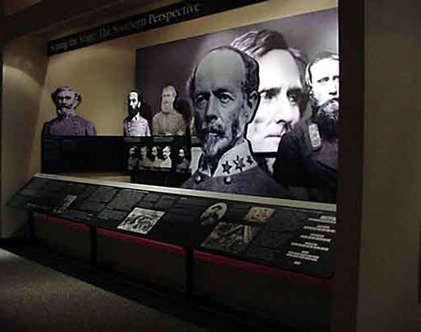
There is time for fun.
Things to do in Kennesaw, Georgia!

Slide 6
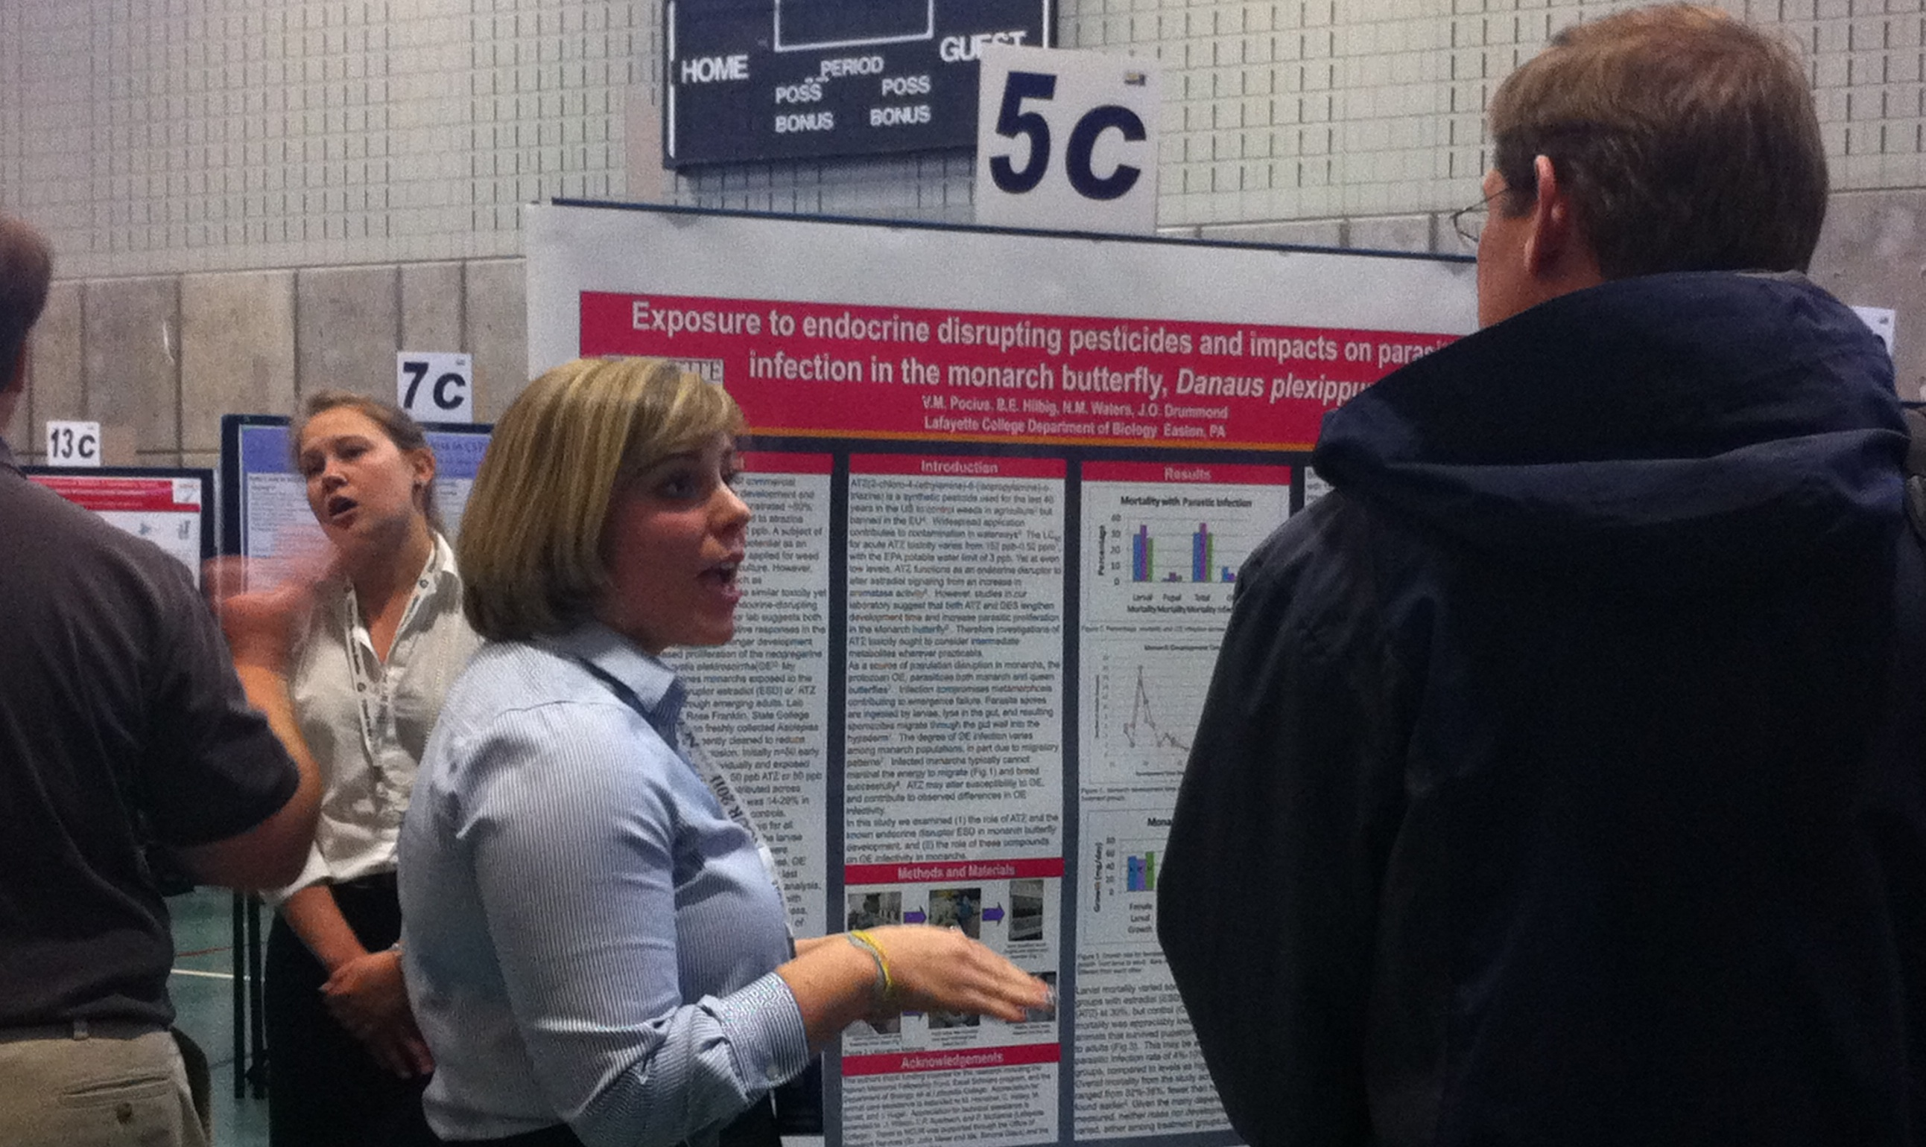
Lafayette has a long history with NCUR
Year-after-year we send around twenty students
Typically 40+ students apply for funding
Make the case!

Slide 7
Two-Step Application Process
Lafayette (internal) process
All submissions are reviewed by Lafayette’s Academic Review Committee
Those approved move to next step
NCUR (external) process
Approved applications must be submitted directly to NCUR by the student

Slide 8
The Lafayette Process
Apply to the Academic Research Committee (ARC) Deadline: October 22, 2018
“How will you benefit from presenting your work at NCUR?”
Title
Abstract (300 words)
Your adviser ALSO needs to complete a separate Qualtrics form by October 22, 2018: Letter of support.
Notification of ARC’s decision: week of November 12, 2018 by email
ARC plans to make select applications from up to 20 students.

Slide 9
The Rest of the Process
If your application is selected by the ARC, you must individually submit your abstract to NCUR
NCUR submission deadline is December 2, 2018
Decisions from NCUR about your application will begin around January 28, 2019 and continue through mid February.
Travel
Departure is April 10 and return is April 13
This information is available on our NCUR webpage:
https://academics.lafayette.edu/undergraduate-research/national-conference-on-undergraduate-research/
Notes:
You will get a Dean’s Excuse and faculty members have always been helpful.
A couple of days before departure we’ll go over all the logistical details.

Slide 10
If your proposal is accepted
Acceptance by NCUR is a commitment that you will attend or you will be asked to reimburse the college for all expenses that were paid on your behalf.
Travel and lodging costs will be covered by the Office of the Provost
Registration and meals not covered by the conference registration (up to $15 per meal, 2-3 meals anticipated) will be covered by the relevant department or program
(please inform your department head or program chair of your participation in NCUR)
Notes:
Mike and Kathleen Dowd run the workshops. Usually one for oral presentations and one for posters. That will be in mid-March.

Slide 11
Spring Student Research Poster Session
All students who submit their applications to ARC (whether or not you present at NCUR) are committed to present at the Spring Poster Session held on campus in April (typically one week following the conference).
Please stay tuned for details regarding the Spring Poster Session.

Slide 12
FAQ
Can I submit more than one abstract?
Yes, two abstracts per primary author are permitted. There is no limit on the number of abstracts submitted per co-author.
What is the most typical format of presentation at the conference?
The most common formats are oral and poster presentations (50/50) .
Will I be excused from my classes?
Yes, participation in NCUR is excused by the Dean.
Can I submit my abstract for approval if my research advisor is not associated with Lafayette College?
Yes.
What about if I won’t have my research completed by the time I need to submit it to the conference?
This is often the case. You need to have a sensible understanding of the risk.

Slide 13
What’s Next?
Title! Abstract!! Benefit!!!
and your project mentor’s endorsement
All submitted to Lafayette ARC by October 22, 2018
Notification is week of November 12, 2018
© UFS, inc.

Slide 14
More Questions?
Please contact Ms. Chelsea Emrick (emrickc@lafayette.edu) if you have questions about participation in NCUR 2019.

